Slide 1
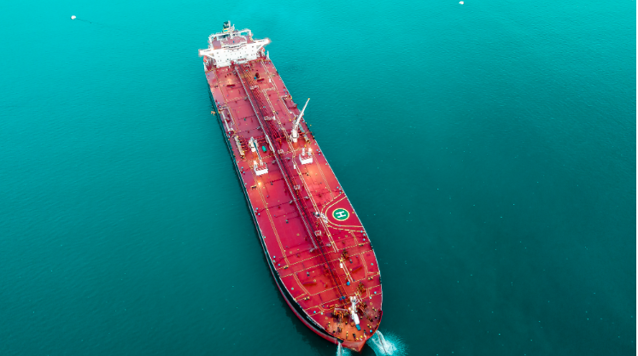
Shıp fuel ın the future
An analysis by Levent Akson
June 2023

Slide 2
Content
Decarbonisation
Shipping and carbon emission
IMO’s initiatives
Alternative Fuel
Steps toward alternative fuels
Alternative fuel – is everything green?
Alternative fuel – drivers
Alternative fuel – what do people think?
Alternative fuel – development
Alternative fuel – existing fleet
Alternative fuel – orderbook
Alternative fuel – the way ahead
Summary

Slide 3
Decarbonısatıon

Slide 6
Carbon neutrality is a global phenomenon
Majority of the countries have made carbon neutrality pledge by 2050. This will significantly affect oil, coal and LNG demand.
Key takeaway
All the countries are working towards aligning themselves with Paris 2016 climate pledge.
Majority of the countries have pledged to be carbon neutral by 2050. Some major countries such as China and India have pledged to be net-zero by 2060 and 2070 respectively.

Slide 7
Energy transition underway
Oil demand in most of the scenarios will flatten or fall significantly by 2050. Natural gas will continue to play a significant role, albeit growth is expected to slow down. During the same time horizon, coal is likely to fall significantly. Renewables will continue to increase in all cases. Hydrogen and Ammonia are likely to emerge as important sources of energy.
Key takeaway
In the last five years International Energy Agency (IEA) has gradually become pessimistic about the outlook of fossil fuels. It has been due to increasing investment in renewable sources of energy.
Climate Bonds forecasts half a trillion US dollars of investment in annual green bond investment in 2021, reflecting the strength of the green market. Green bonds have been soaring at a 49% growth rate in the five preceding years before 2021.
There has been a formation of an industry-led, UN-convened Net-Zero Banking Alliance with 53 members in 27 countries with US$37 trillion in assets- representing almost a quarter of banking assets worldwide
Glasgow Financial Alliance for Net Zero (GFANZ) has over 250 financial institutions from 32 countries, representing over US$88 trillion in assets.
Exajoules
Source: IEA

Slide 8
shıppıng and carbon emıssıon

Slide 9
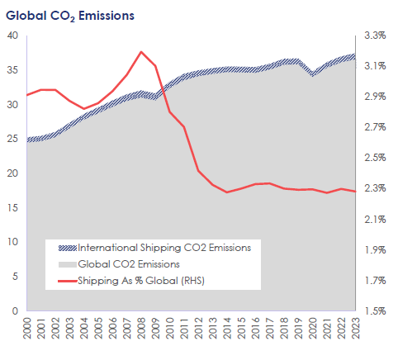
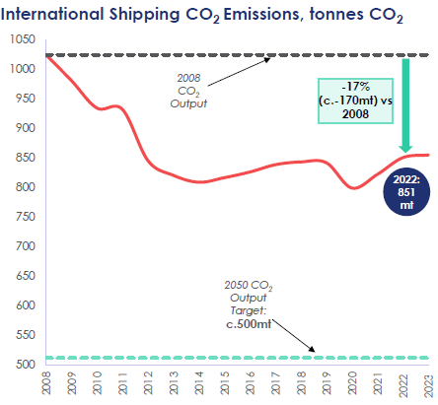
A push towards decarbonisation

Slide 10
Imo’s ınıtıatıves

Slide 11
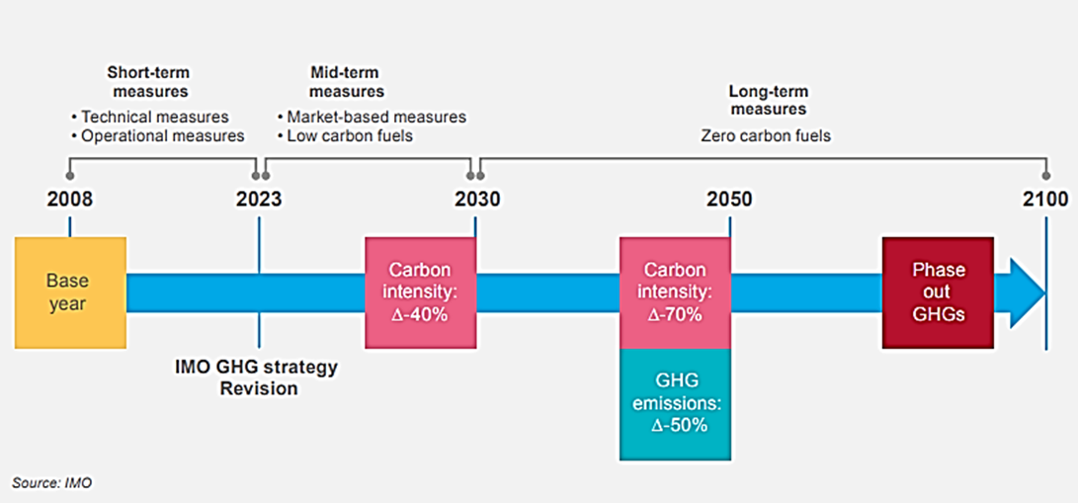
IMO initial GHG Strategy

Slide 12
Current scenario
Energy efficiency can be improved either by reducing emissions by using alternative fuel, speed reduction, or by other means
It can also be improved by increasing transport power, by installing Propulsion Improving Devices (PID)
Therefore, vessels could reduce speed to comply with emission regulations, and this methodology does not involve any retrofitting or capex.

Slide 13
EEXI and CII
Speed Reduction
The introduction of EEXI and CII in 2023 would require an assessment of the design, and operational carbon intensity of the vessel. Requirements to comply are stringent with reduction factors increasing over the years.
EEXI
CII
2023
2024
2025
2026
5% reduction
factor
2023: Introduction of design parameter EEXI, and operational parameter CII. Compliance with EEXI may require vessels to implement Engine Power Limitation (EPL), limiting the maximum speed of vessels.
7% reduction factor
2024: Increase in reduction factor for CII. Vessels lying in Category E in 2023 will have to submit a plan to improve carbon intensity.
9% reduction factor
2025 : Increase in reduction factor for CII. Vessels lying in Category E in 2023 will have to submit a plan to improve carbon intensity.
11% reduction factor
2026: Vessels lying in Category D for years 2023 – 2025 together with vessels lying in category E in 2025 will have to submit a plan to improve carbon intensity.
Beyond 2026
??
??
Note: The given percentages are carbon intensity reductions, not speed reductions.

Slide 14
Future?
Alternative fuel
Speed Reduction
Alternative Fuels
Others
Reduce CO₂ emission
Ammonia
Hydrogen
Other fuels
One long-term alternative fuel or “multi-fuel” future?
Others: Propulsion Improvement Devices (PIDs) and Energy Saving Devices (ESDs)

Slide 15
Alternatıve fuel

Slide 16
Formation of Green Corridors
As we start transitioning towards alternative fuels, the availability of fuels, their acceptability, etc. is expected to be challenging. Therefore, major stakeholders have joined forces to establish green corridors in some selected trade routes. In these green corridors, alternative fuel will be available, thereby encouraging ship owners to deploy alternative fuelled vessels.
Source: Zero-Emission Shipping Mission

Slide 17
Alternative fuels
Alternative fuels include various fuels other than the conventional fuels that are currently used. - heavy fuel oil (HFO) and very low sulphur oil (VLSO)
Alternative fuels can be further categorised into:
Grey fuels, which produce emissions that are not captured
Blue fuels, which produce carbon emissions that are captured
Green fuels, which do not produce any carbon emissions
Main alternative fuels
Biofuel
Methanol
LNG
Hydrogen
Ammonia

Slide 18
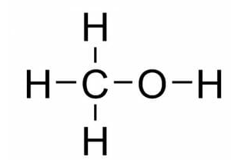
Various alternative fuels
Biofuels
Methanol
Biofuels are produced from vegetable and animal oils or their waste.
They do not result in carbon emissions reduction during the combustion process. However, these emissions can be partially or fully offset during their production.
They are a ‘drop-in’ fuel, which means that they can be directly used in place of an existing fuel with minimal alterations.
Therefore, biofuels are an excellent alternative fuel for the short to medium term, provided that sufficient sustainable biofuels are available.
Currently, almost all methanol is produced using natural gas and coal. However, it can also be produced from biomass and renewable electricity.
Methanol is becoming popular alternative fuel due to its ease of handling and lesser emissions.

Slide 19
Various alternative fuels
LNG
LNG has gained considerable popularity as it is the most easily available alternative fuel because it has lower CO2 emissions than conventional fuels.
However, there is methane slip during its life cycle, from the process of its extraction to final combustion.
Methane slip does not cause any CO2 emission, but results in methane emission, which is far more harmful GHG.
LNG can later be replaced with bio LNG and synthetic LNG, which have even lower emissions.
Hydrogen
Hydrogen can be produced by various methods:
If produced from natural gas in conjunction with carbon capture, it is called blue hydrogen.
If produced using renewable electricity, it is called green hydrogen.
Requires special storage tanks with temperatures of -253ºC to maintain hydrogen in a liquid state.
Highly flammable and prone to leakage.
Needs large storage space and is not expected to be directly used as fuel in cross-ocean voyages.
Ammonia
Does not have carbon; therefore, it is a zero-carbon fuel.
Needs lesser space than hydrogen and is considered one of the main fuels in the long run.
Using Ammonia in engines produces nitrous oxide (laughing gas) which is a more potent GHG gas than CO2.
Ammonia engines are likely to be ready by 2024.
Highly toxic to human and aquatic life.

Slide 20
Steps toward Alternatıve fuel

Slide 21
Investment pouring in ammonia
Key takeaways
The Japanese government has included ammonia as one of the important energy sources for the country and is likely to consume 3 mtpa by 2030.
Itochu is set to begin commercial production (1 mtpa) of ammonia (with CCUS) in Canada in 2026. It will be shipped to Japan in Very Large Ammonia Carriers.
Mitsubishi Power is developing a 40-MW class gas turbine that can directly combust 100% ammonia, expected by 2025.
Ammonia is a promising alternative fuel to achieve zero-carbon target. There are more than 30 green ammonia projects globally, with a total potential capacity of over 35 mtpa.
Electricity Source
Wind & Solar
Wind
Solar
Grid Electricity
Hydro
Plant Size, kt per year
> 800
< 800
< 400
< 40
Most of the invested plants are planned to produce green ammonia which uses hydrogen produced by electrolysis with atmospheric nitrogen.

Slide 22
Massive investment in hydrogen
Key takeaways
According to Hydrogen Council, hydrogen can become a competitive low-carbon solution in more than 20 applications by 2030, including long-haul trucking, shipping and steel production
Deepsea vessels however are not expected to be fuelled by hydrogen due to low energy density of hydrogen and space constraints on the vessel.
Over 800 hydrogen projects globally in various stages provide an estimated overall capacity of 65 mtpa.
Electricity Source
Wind
Solar
Hydro
Plant Size, kt per year
> 800
< 800
< 400
< 40
Over 800 hydrogen projects globally in various stages providing an estimated overall capacity of 65 mtpa; aligned with the hydrogen demands of the Announced Pledges Scenario. These projects do not only aim to produce hydrogen as the end product, but also as intermediate and feedstock to produce other alternative fuels such as ammonia and methanol.
A combined investment of more than USD$300 billion has been made for these projects, likely due for completion in 2030.
Source: IEA, IRENA, BP

Slide 23
alternatıve fuel – ıs everythıng green?

Slide 24
Fuels available | Current status | Benefits | Restrictions
MDO/MGO/LSFO | Current standard fuel in the marine industry | Easy to adopt, fuel efficiency improving due to (i) general fleet renewal and (ii) new technologies, slow steaming can reduce carbon | High GHG, PM, Nox, low sulphur fuel more expensive
LNG | Requires LNG capable engines with different fuel handling system and increased fuel storage space required | Safe to use, proven technology, bunkering network evolving, very low Nox, Sox, PM>20% less CO2. LNG carriers can use waste boil-off gas | Methane slips, still a fossil fuel, regional variation in bunkering availability, future LNG pricing uncertain, high CAPEX (especially retrofit), potential loss of cargo capacity
LPG | Requires LPG capable engineswith different fuel handling system | Low Nox, Sox, Lower CO2, LPG carrier can use cargo as fuel, extensive terminal infrastructure | Limited uptake as a marine fuel to date outside of LPG carriers, still a fossil fuel, economic incentive depends on pricing.
Methanol | primarily produced from natural gas, although increased development of 'green' methanol. Can be used in dual-fuel oil/methanol engines | Fuel handling and risk management simpler than LNG, zero CO2 emission for 'green' methanol reduced Nox, Sox, existing terminal infrastructure | Retrofit can be complex, low energy density, likely to be costly in the short term, toxic and flammable, global production limited
Biofuels | While many engines are compatible, some ships require modification to fuel system and engine | Some types of biofuels already widely available at competitive prices and can use existing waste products. Requires limited changes to engines and fuel handling | Typically no CO2 reduction from vessel itself, emission vary according to supply chain, sustainability issue (e.g. land use for palm oil production)
Hydrogen | Development focused on zero-emission fuel cells, can also be used in specialist combustion engines | Potentially, both clean and abundant, attracting significant investment in technology, fuel cells more efficient than combustion engines | Fuel production is still energy intensive, large scale production expensive, undeveloped bunkering infrastructure, expensive to store at -253 degree Celcius
Ammonia | Can be produced from catalytic reaction of nitrogen from air and hydrogen from water and used in combustion engines or fuel cells | Already produced and traded at scale, zero emission from vessel itself, 'green' ammonia could be fully GHG emission free. | Current production process (Haber Bosch) is highly energy intensive, much less energy dense than oil-based fuels, toxic and corrosive, significant Nox emissions.
Batteries | Batteries can store electrical energy for propulsion by charging ships using High Voltage Share Connection | Ship itself does not generate emission, could be carbon free, if onland power source is green too, already in use for small ferries, expanding network of HVSC facilities at ports. | Impractical for larger vessels or those on long voyages, due to size of batteries needed, upstream emission still possible, potential loss of cargo space, unsuitable for many locations
Synthetic Methane | Fuel produced by combining Hydrogen produced using excess energy from renewables and waste CO2 | Fuel could be used in LNG capable engines, potential for extend LNG beyond 'bridging fuel, good method of Carbon capture and reuse. | Production process is still very energy inefficient and costly
Nuclear | Powered by small nuclear power plants | Extremely high power, mature technology, minimal emission from ships. | Emission still produced by fuel production, creation of nuclear waste, significant risks, adoption faces political and regulatory issues.

Slide 25
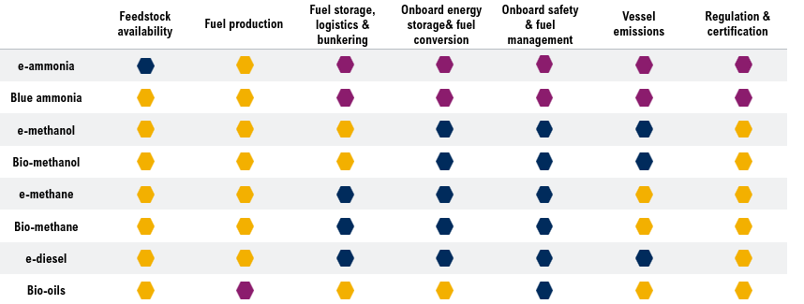
Alternative Fuel Pathway Maturity Map
There are major challenges in making ammonia a viable alternative fuel. The challenges pertaining to various aspects such as fuel storage, logistics and bunkering, onboard energy storage & fuel conversion, fuel management, regulation and certification etc. Hydrogen has not been included here as it will likely be used only for short-sea shipping.
Mature
Solutions are available, and none or marginal barriers identified.
Solutions identified
Solutions are available, and none or marginal barriers identified.
Major challenges
Solutions are available, and none or marginal barriers identified.

Slide 26
Understanding emissions
Source: Pusan University

Slide 27
Well-to-wake emissions for different fuels
Source: NTNU

Slide 28
alternatıve fuel – drıvers

Slide 29
Drivers and key issues for successful adoption of alternative fuels
Drivers for successful adoption of alternative fuel
Fuel availability and bunkering infrastructure
Others
Marine engines and vessels design
Shipowners motivation

Slide 30
Drivers and enablers
The first movers to take action are split into the transition drivers and market enablers. Everyone from alternative fuel producers, ports & terminals, vessel owners & operators to regulations & policies making, financing and cargo & customers would have to work hand in hand and step up in order for change to take place.
Transition drivers
Alternative fuel producers | Ports & terminals | Vessel owners & operators
Unlock barriers to enable all alternative fuel pathways Promote and scale commercially available alternative fuels | Re-purpose existing infrastructure to support uptake of alternative fuels Share learnings and develop blue-prints on safe handling of all alternative fuels | Order dual-fuel ships Maximize energy efficiency Send demand signals to fuel producers Deepen dialogue and green service offering with customers
Market enablers
Regulation and policy making | Financing | Cargo owners & customers
Focus on removing barriers and closing cost-gaps Present long-term regulatory roadmaps and experiment with regulatory sandboxes to find solutions fast Introduce carbon pricing | Mobilise capital to decarbonisation technologies Engage in private-public partnerships De-risk investments by providing e.g. cheaper capital, governmental guarantees, subsidies | Be transparent about green shipping demand Be willing to share some of the costs of alternative fuels Work to find solutions to aggregate fragmented supply and demand

Slide 31
alternatıve fuel – what do people thınk?

Slide 32
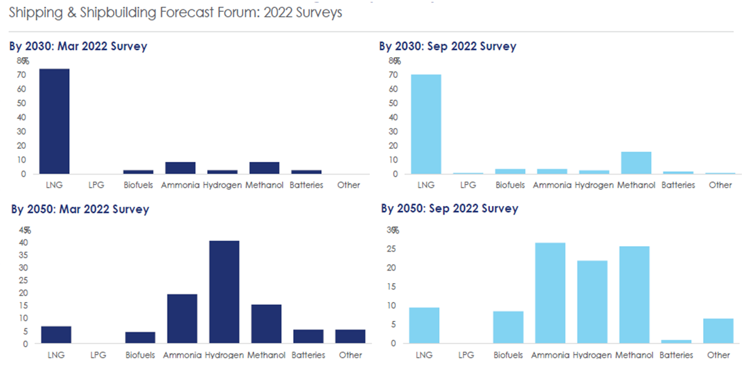
Which alternative fuel will have the highest uptake by 2030/2050?

Slide 33
alternatıve fuel – development

Slide 34
Developments in ship technologies
Total number of ship technology projects by fuel

Slide 35
alternatıve fuel – exıstıng fleet

Slide 36
Alternative fuel uptake: Existing fleet
Currently, a meagre 1% of the global fleet has alternative fuel propulsion systems.

Slide 37
Alternative fuel uptake: Existing fleet

Slide 38
Alternative fuel uptake: Existing fleet

Slide 39
Alternative fuel uptake: Existing fleet

Slide 40
Alternative fuel uptake: Existing fleet

Slide 41
Alternative fuel uptake: Existing fleet

Slide 42
alternatıve fuel – orderbook

Slide 43
Alternative fuel uptake: Orderbook
Orderbook is fast catching up with 22% of new orders having low or zero carbon propulsion system.

Slide 44
Alternative fuel uptake: Orderbook

Slide 45
Alternative fuel uptake: Orderbook

Slide 46
Alternative fuel uptake: Orderbook

Slide 47
Alternative fuel uptake: Orderbook

Slide 48
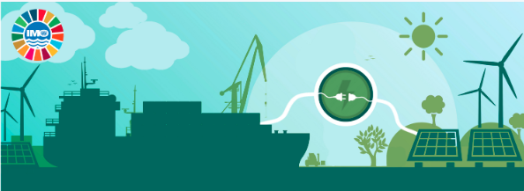
Alternative fuel uptake: Orderbook

Slide 49
alternatıve fuel – the way ahead

Slide 50
Expected path to decarbonisation
Decarbonisation measures and upgrades are necessary for the short run. Some require investments, and some are operational in nature. Most of these require small investments, which can be financed from the equity of the large shipowners or through corporate debt. There will be a significant need for capital investment after 2025 when ships powered by alternative fuel start to be ordered. Some estimates suggest needing for above USD3 trillion to achieve decarbonisation in shipping.
Already implemented
Hull Optimisation
Upgrade in 2023 ±2 years
High-performance coating
Energy-saving device
Energy-efficient lighting system (LED, Light-emitting Diode)
Variable-frequency drive-controlled pumps, fans and motors
Shaft generator PTO/PTI
Waste-heat recovery
Battery Hybridisation
Wind-assisted propulsion
Trim optimisation
LSFO and/or MDO
Upgrade in 2028 ±2 years
New, more-efficient power providers, e.g. fuel cells
Wind-assisted propulsion
High-efficiency Propeller
Efficient coating system
Electronic auto-tuning
Improved engine load
Wind-assisted propulsion
Weather routing
Voyage planning and execution
LSFO and/or MDO
Speed reduction
Biofuel or synthetic fuel
Hydrodynamics
Machinery
Wind
Operational
Fuel

Slide 51
Initiatives for decarbonisation spread across all elements of the maritime ecosystem
Voyage Optimisation
Weather routing: setting the optimal route between two points.
Financing framework
Sustainability linked loans/bonds (2020) aim to facilitate and support environmentally and socially sustainable economic activities and growth. These principles are voluntary recommended guidelines for loans/bonds to be recognized as sustainable. The sustainability linked loans/bonds enable lenders/investors to incentivize the sustainability performance of the borrower/issuer and align the cost of financing with a borrower's performance measured against prescribed sustainability performance targets. Sustainable linked finances have clearly defined sustainability targets. Improvements in CO₂ intensity are measured using Average Efficiency Ratio (AER). Across all shipping sectors, 15 sustainability-linked deals worth USD3 billion were concluded from Jan-Aug 2021.
Zeronorth platform consists of Voyage Planning and Execution, Hull Performance Monitoring, Technical Optimisation, Bunker Optimisation, Chartering Optimisation, Vessel Reporting Platform
Blue Visby: A multilateral platform for reducing shipping GHG emissions by 15% through eradicating the practice of “Sail Fast, then Wait” without the obstacles of “just in time”. It focuses on single type of vessel for a specific port.
Just in time: IMO has been promoting just in time ship operations.
Government incentives
Investment in hydrogen
Investment in ammonia
Green Shipping Programme of Norway focusses on incentivising net-zero emissions from vessels
There are currently more than 800 hydrogen production projects. With more than 220 of these projects considered to be large-scale. These projects are regardless of the hydrogen’s end goal – be it for producing ammonia, methanol, iron & steel, biofuels, etc. These hydrogen production plants come with a total potential capacity of over 65 mtpa.​
There are more than 30 green ammonia projects globally, with a total potential capacity of over 35 mtpa. While it is seen that a high concentration of proposed plants are based in Australia, there are notable developments from other regions of the world – such as Europe, Americas and the Middle East. Some projects are expected to commence operations as early at 2023.​
European Union’s Horizon 2020 programme.
Development Bank of Japan Inc. (DBJ) and ClassNK established "Zero-Emission Accelerating Ship Finance (Program)" to support the maritime industry's transition toward decarbonization.

Slide 52
Initiatives for decarbonisation spread across all elements of the maritime ecosystem
Government collaboration
Clyde Bank Declaration (2021): It is a coalition of 22 governments to support the establishment of green shipping corridors – zero-emission maritime routes between 2 (or more) ports. It aims to establish at least 6 corridors by 2025.
Class Society
Engine Makers
The Pacific Blue Shipping Partnership (PBSP)-2019
Fiji, Marshall Islands, Vanuatu, Tuvalu, Solomon Islands, Tonga, Kiribati launched a partnership to make shipping in the Pacific Ocean zero carbon by 2050. Developing a blended finance package exceeding US$500 million to enable a 10-year initial work programme
Giving approval in principle for ammonia ready vessels.
MAN Energy Solutions aims to have a commercially available two-stroke ammonia engine by 2024, followed by a retrofit package for the gradual rebuild of existing maritime vessels by 2025.
Private initiatives
Market-based Measures, such as a GHG levy/Carbon taxation, Emissions Trading Scheme or other economic instrument is being considered as one of the tools for promoting decarbonisation. They, as well as, other forms of fund raising, can help finance research and development in the decarbonisation ecosystem such as alternative fuel, bunkering infrastructure etc and provide level playing field for alternative fuels. It may help in reducing the risk of investment in alternative fuel. Ships continuing to consume HFO may require to pay carbon taxes or participate in emissions trading depending on the final legislation.
Cross-sectoral collaboration
The Getting to Zero Coalition (2018) is an alliance of more than 200 organizations (including 160 companies) within the maritime, energy, infrastructure and finance sectors, supported by key governments and Intergovernmental Organisations. It is aimed at accelerating maritime shipping's decarbonization with the development and deployment of commercially viable deep sea zero emission vessels by 2030 towards full decarbonization by 2050.
Wärtsilä has already proven an engine concept running on blends of up to 70% ammonia so far and will have a concept running on pure ammonia by 2023
Global Centre for Maritime Decarbonisation (2021): with funding from the Maritime and Port Authority of Singapore (MPA), and six founding partners, namely BHP, BW, DNV Foundation, Eastern Pacific Shipping, Ocean Network Express and Sembcorp Marine. Focussed on Ammonia, Sustainable biofuel, methanol.
Mærsk Mc-Kinney Møller Center for Zero Carbon Shipping aims to sustainable decarbonization of the maritime industry by 2050 through collaboration, applied research and regulatory reform.
Developing bunkering processes, safety guides and other technical documents.

Slide 53
Initiatives for decarbonisation spread across all elements of the maritime ecosystem
Banks and Financial institutions
Poseidon Principles (2019): World’s first sector-specific, self-governing climate alignment agreement amongst 30 financial institutions (with equivalent to more than USD200 billion (>50%) of global shipping loan portfolio) to integrate the IMO’s policies on climate change into ship finance decision making processes.
Insurers
Poseidon Principles for marine insurers (2021): Group of nine insurers. The aim is to enable insurers to assess and disclose their portfolios with responsible environmental impacts and incentivize international shipping’s decarbonization
Charterers
Sea Cargo Charter (2020): A group of 34 bulk ship charterers. It is a global framework that allows for the integration of climate considerations into chartering decisions to favor climate-aligned maritime transport.
Cargo owners
coZEV (2021): Cargo Owners for Zero Emission Vessels: cargo owner-led network to enable maritime freight customers to come together to accelerate maritime shipping decarbonization through a series of actions and projects.
Shipyard
Japanese shipyards aim to commercialise a zero-carbon emitting vessel by 2028.
Shipowners ongoing initiatives
Shipboard carbon capture
The Global Environment Facility Trust Fund (2020): IFC-GEF Green Shipping Investment Platform was approved in 2020. The Green Shipping Platform aims to create a first-of-its-kind global investment vehicle solely focused on decarbonizing the shipping industry.
ZEMBA: Zero Emission Maritime Buyers Alliance: to accelerate commercial deployment of zero-emission shipping, enable economies of scale, and maximise cargo owners’ collaborative emission reduction potential beyond what one freight buyer could accomplish alone.
Switching to alternative fuel such as LNG, methanol,
Harnessing wind and solar power
Electrification of vessels such Swappable battery
Retrofitting energy saving devices such as air lubrication system
Proof of concept and pilot projects for ammonia and hydrogen propelled vessels are accelerating.
In addition, investment in new class of assets such as CO₂ carrier, Hydrogen carrier, large ammonia carriers are taking place increasingly.

Slide 54
Energy Transition in shipping: Issues and Constraints
Key takeaway
1% of the existing global tonnage is capable of burning alternative fuel.
About 22% of global order book is alternative fuel capable.
LNG is the preferred fuel for shipowners followed by methanol.
There is a lack of alternative fuel bunkering (particularly low/zero carbon) facilities.
Higher capex and high fuel costs for alternative fuel vessels
The shipowners have to secure long-term supplies before investing in alternative fuel-propelled ships either by investing in fuel production or contracting with the fuel producers.
These constraints have dissuaded owners from ordering alternative fuel propelled ships.
Issues
1. Currently fuel emission is measured from tank to propeller. There has been a gradual transition towards well-to-propeller measurement method.
2. Slow uptake of alternative fuel in global tonnage (0.9% in fleet and 20% in orderbook).
3. Green Ammonia and Green Hydrogen are touted as zero emission fuel.
4. Currently, LNG, LPG and Methanol are the preferred fuel.
Constraints
1. No consensus on measurement method.
2. Higher capex for dual fuel vessels. In addition price of alternative fuel is significantly higher. Given greater space requirement for alternative fuel, shipowner has to compromise on revenue earning space.
3. Lack of sufficient production of zero/low carbon bunker fuel. In addition, there is low technological readiness in ammonia / hydrogen-propelled vessels. The safety concerns associated with ammonia and hydrogen fuel still remains. There is also a lack of operational procedures and regulation.
4. Lack of LPG and methanol bunkering facility in the world. Therefore, some of the large shipowners are having to secure long term alternative fuel supply.

Slide 55
alternatıve fuel – summary

Slide 57
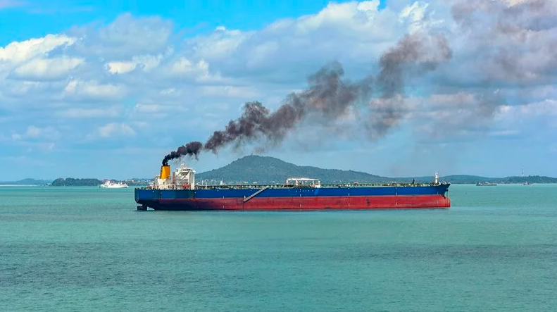
Summary: Alternative fuel uptake
About 1% of the existing global tonnage is capable of burning alternative fuel. LNG is the preferred fuel for shipowners; about 22% of the vessels on orderbook are alternative fuel capable. LNG is also the preferred fuel, and methanol is gaining momentum.
About 0.3% of the existing global MPV tonnage is capable of burning alternative fuel. LNG is the preferred fuel for shipowners. About 9% of the MPV vessels on orderbook are alternative fuel capable. LNG is the preferred fuel, and methanol is gaining momentum.
About 0.3% of the existing global MPV tonnage up to 10,000 dwt is capable of burning alternative fuel. LNG is the preferred fuel for shipowners. About 5% of the MPV vessels upto 10,000 dwt on orderbook are alternative fuel capable. LNG is the preferred fuel.
The higher emissions from older vessels will pose a challenges for their employability as charterers will prefer higher-rated vessels.
There are major challenges in making ammonia a viable alternative fuel. The challenges pertaining to various aspects such as fuel storage, logistics and bunkering, onboard energy storage & fuel conversion, fuel management, regulation and certification etc. Hydrogen has not been included here as it will likely be used only for short-sea shipping.
The first movers to take action are split into the transition drivers and market enablers. Everyone from alternative fuel producers, ports & terminals, vessel owners & operators to regulations & policies making, financing and cargo & customers would have to work hand in hand and step up in order for change to take place.
Decarbonisation measures and upgrades are necessary for the short run. Some require investments, and some are operational in nature. Most of these require small investments, which can be financed from the equity of the large shipowners or through corporate debt. There will be a significant need for capital investment after 2025 when ships powered by alternative fuel start to be ordered. Some estimates suggest needing for above USD3 trillion to achieve decarbonisation in shipping. Fundings will only be available for climatically aligned projects from some financiers.
There is a lack of alternative fuel bunkering (particularly low/zero carbon) facilities. Because of higher capex and high fuel costs for alternative fuel vessels; the shipowners have to secure long-term supplies before investing in alternative fuel-propelled ships either by investing in fuel production or contracting with the fuel producers.
The order for low carbon fuel vessels will continue to rise over the next five years with increasing pressure of compliance with upcoming decarbonisation regulations.

Slide 58
Thank you

